Slide 1


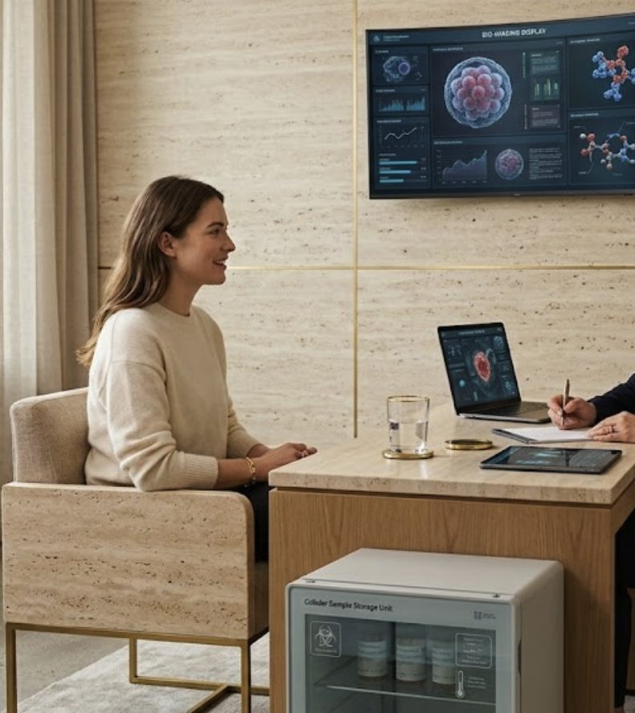
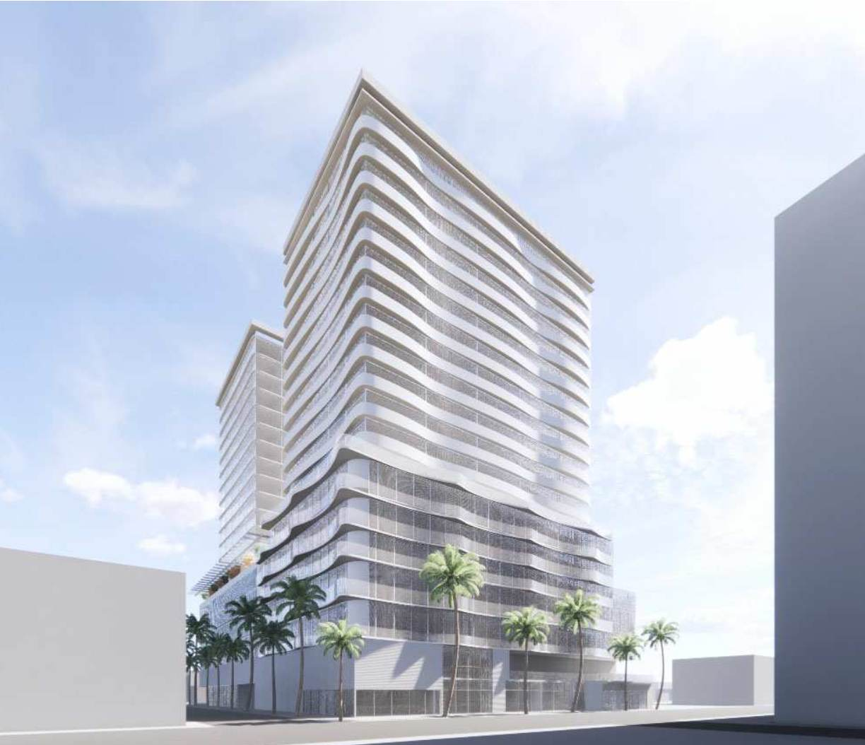
Aethera — Greek for the breath of the gods.
PRIVATE OFFERING · FRIENDS & FAMILY · REG D 506(b) · CONFIDENTIAL
Regenerative medicine,
engineered like an operating system.
Ten integrated clinics across ten cities — four clinical engines, CLIA diagnostics, IRB-governed research with chain of custody. Built by the operators behind RegenHealth Physicians of NY.
$5.5M
10
50% → 20%
CAPITAL RAISE
CLINICS · 10 CITIES
PROFIT SHARE → EQUITY
Q3 2026 · Jaye Patel · office@aetheramedical.com
INSIDE AN AETHERA CLINIC — PHYSICIAN-LED REGENERATIVE CARE

Slide 2
01 THE OPPORTUNITY
A ~$90B market by 2030. No national standard of care.
~$90B
50M+
1st
REGEN MED MARKET BY 2030 (GRAND VIEW RESEARCH)
U.S. ADULTS LIVING WITH CHRONIC PAIN (CDC)
TO UNIFY REGEN CARE, CLIA DIAGNOSTICS & IRB RESEARCH
Fragmented supply
Cash-pay economics
Evidence engine
Single-doctor practices. No shared protocols, no brand, no buying power, no research infrastructure.
Memberships, procedures, diagnostics and IV therapy are predominantly cash-pay — ~60% gross margins, zero reimbursement risk.
Ten IRB-governed sites with CLIA diagnostics and chain of custody generate trials, publications and IP no single clinic can produce.
Aethera Medical Group is built to be the category-defining brand — protocol-driven, multi-city, physician-led.
AETHERA MEDICAL GROUP · PRIVATE & CONFIDENTIAL · aetheramedical.com

Slide 3
02 TRACK RECORD
We built this model once. Now we own it.
THEN
NOW
RegenHealth Physicians of NY
Aethera Medical Group
Our founders helped develop RegenHealth (rhpny.com) — live, operating clinics — and continue to support them today.
The playbook is validated: clinical protocols, patient acquisition, physician recruitment, multi-state licensure.
Our own combined model — four engines + diagnostics under one roof, our own 8-person leadership team.
49-state licensure — immediate nationwide expansion capability (Dr. Gaurav Patel, CMO).
Research infrastructure — IRB (USMLE100) + CLIA labs (SelfHealth) + biologics supply (RediCell × Auvum Bio).
Four verticals — satellite, clinic, flagship, online — one platform, four ways to scale.
AETHERA MEDICAL GROUP · PRIVATE & CONFIDENTIAL · aetheramedical.com

Slide 4




03 THE PLATFORM
Four clinical engines. One diagnostics backbone.
ENGINE 1
ENGINE 2
ENGINE 3
ENGINE 4
Aethera Cellular Medicine
NeuroRenew Clinics
JIV — Just IV Drip Bar
Fulcrum Performance
Physician-led regenerative & cellular therapies; biologics via Auvum Bio.
Dr. Miller's neuropathy program — laser & light, functional neurology. Compact equipment.
Physician-supervised IV lounge. The retail front door that feeds the clinical platform.
Patented NovaKey™ + SSBreath™; flagships operating in NY, NJ & DR.
DIAGNOSTICS BACKBONE — SELFHEALTH
REVENUE MIX — $150K / CLINIC / MONTH
CLIA-certified, live in all 50 states. On-site specialized panels — including StemAge™ — designed to USMLE100 and medical-team recommendations. ~40% margins, zero extra buildout; patients monitored at the clinic level.
Memberships $45K · Regenerative + NeuroRenew $40K · Diagnostics $20K · JIV $15K · Telehealth $10K · Retail $10K · Fulcrum $10K
1,500–3,000 sq ft · 3–5 universal rooms — injections, infusions & diagnostic draws in any room · all engines share space, no bottleneck — maximum revenue per square foot.
AETHERA MEDICAL GROUP · PRIVATE & CONFIDENTIAL · aetheramedical.com

Slide 5
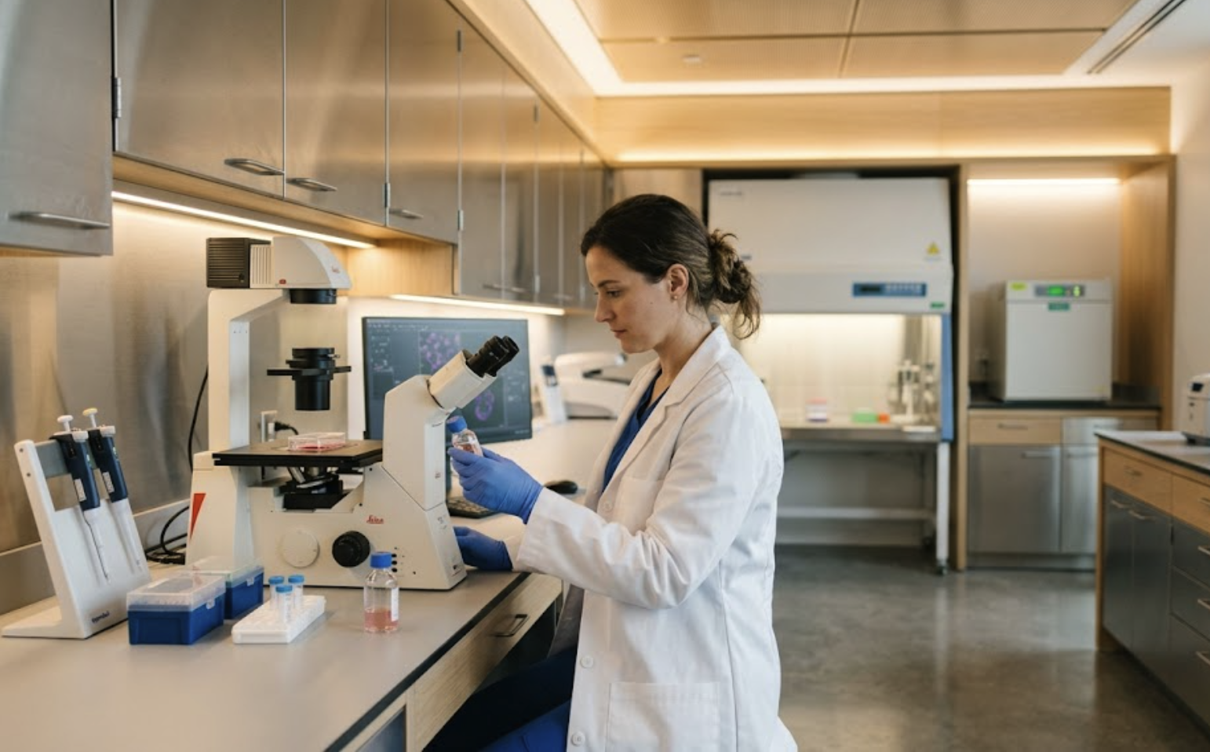
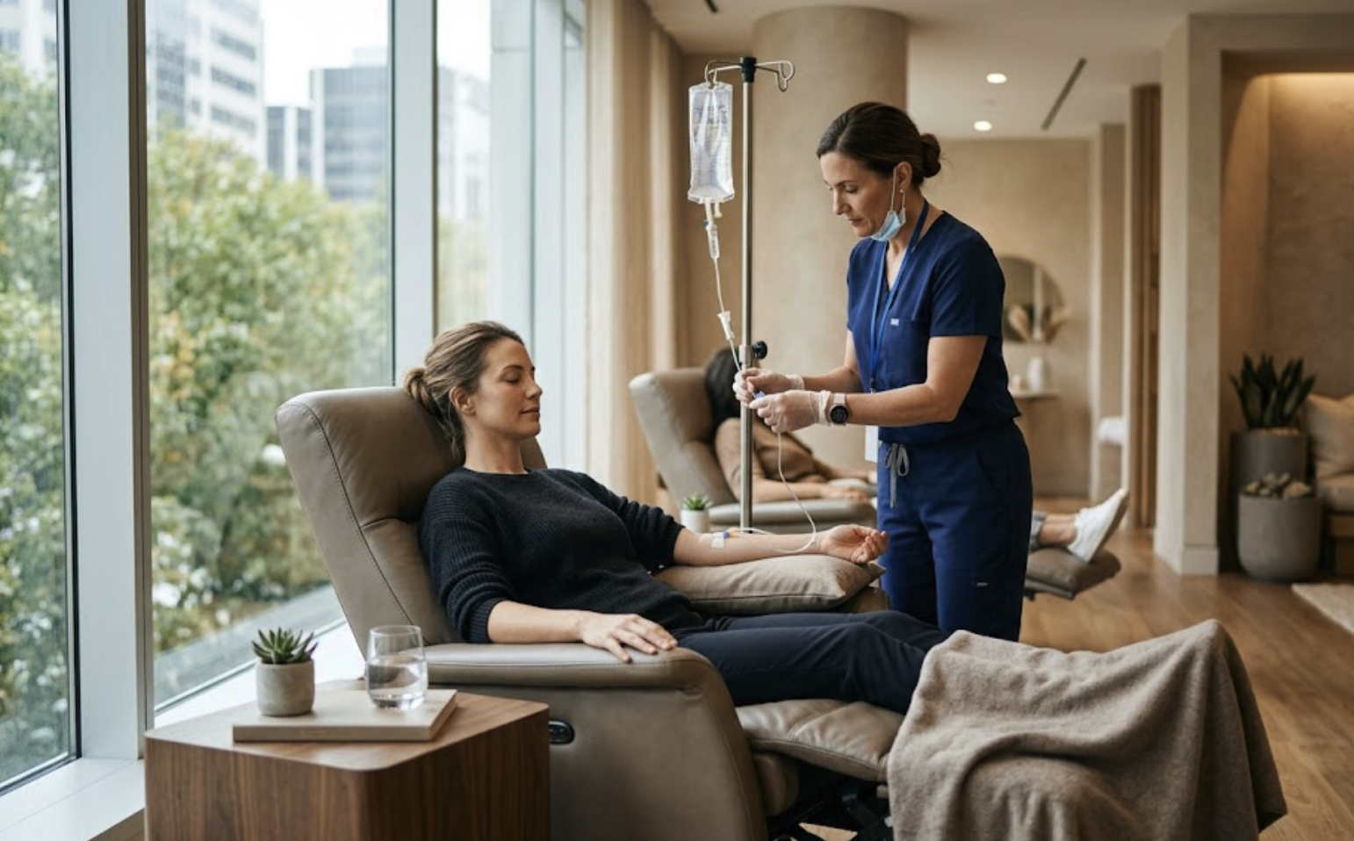
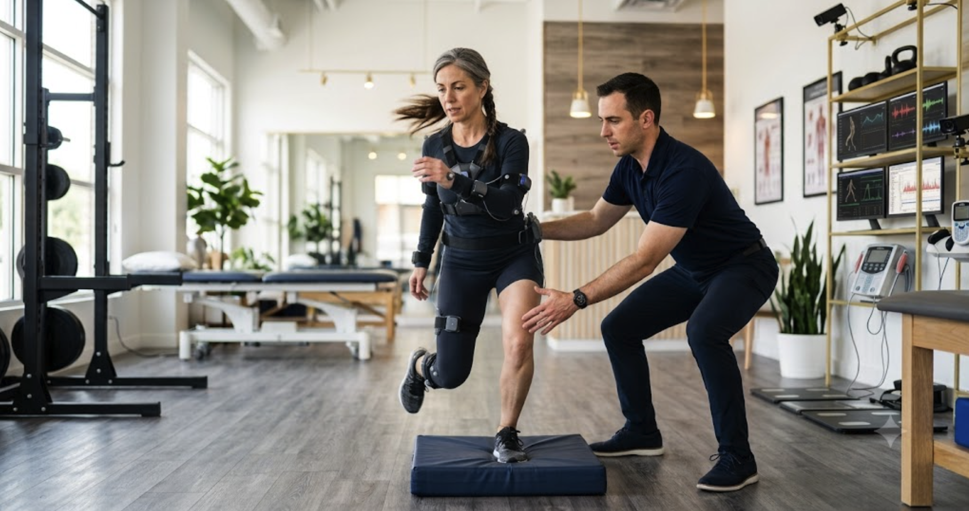
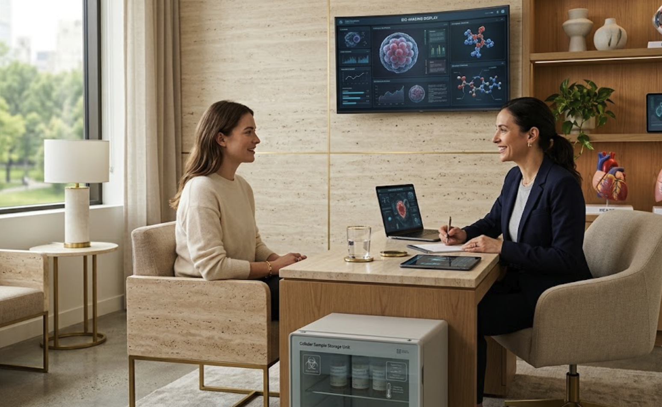







THE CLINICAL REALITY
Inside Aethera — from research bench to clinical suite.
Regenerative-medicine laboratory · biologics via RediCell × Auvum Bio
JIV — physician-supervised IV therapy in a calm clinical lounge
Fulcrum Performance — sensor-guided training (NovaKey™ + SSBreath™)
Physician-led consultation — diagnostics, regenerative care & research
OUR ECOSYSTEM
PRIVATE & CONFIDENTIAL · AETHERAMEDICAL.COM

Slide 6
04 FOUR VERTICALS
One platform. Four ways to scale.
THIS RAISE — 10 UNITS
V1
V2
V3
V4
Satellite
Aethera Clinic
Flagship Wellness Center
Online Clinic
400–1,000 sq ft · gyms, hotels, wellness centers & partner clinics
1,500–3,000 sq ft · 3–5 consult rooms
10,000–15,000 sq ft · full buildout + spa & hospitality
Registered patients only
First sites: Dr. Miller's TN & N. CA clinics · hotel menus for travelers & guests
~$550K all-in · M1–15 · core P&L + research
$4M+ · Round 2 · Fulcrum flagships live: NY · NJ · DR
Platform funded now · retention & LTV
The $5.5M funds Vertical 2. Satellites and the online clinic extend it from cash flow; the flagship is Round 2 — investors hold first rights on all three.
AETHERA MEDICAL GROUP · PRIVATE & CONFIDENTIAL · aetheramedical.com

Slide 7
05 UNIT ECONOMICS
One clinic, stabilized month.
Revenue — Memberships & wellness plans | $45,000
Revenue — Regenerative + NeuroRenew | $40,000
Revenue — Clinical diagnostics (SelfHealth) | $20,000
Revenue — JIV cross-referrals | $15,000
Revenue — Telehealth · retail · Fulcrum | $30,000
Total revenue | $150,000
Direct costs (40%) | ($60,000)
Gross profit — 60% | $90,000
Clinic operating expenses | ($48,000)
Clinic EBITDA — 28% | $42,000
$504K
~6 mo
ANNUAL EBITDA PER CLINIC
RAMP TO STABILIZATION
$550K
~18 mo
ALL-IN CAPITAL PER CLINIC
CLINIC-LEVEL PAYBACK
Conservative by design
We print 60% GM / 28% clinic EBITDA — deliberately below our internal modeling — and let the live model show the upside. The plan works even if we're wrong by a margin.
AETHERA MEDICAL GROUP · PRIVATE & CONFIDENTIAL · aetheramedical.com

Slide 8
06 SITE PIPELINE
Ten cities. Five launch sites scoped, five in active selection.
City | Site / corridor | Size | Rent
Boston | Longwood Medical · 319 Longwood Ave | 1,150 sf | $6,229/mo
Miami | Aventura Medical Tower · 2801 NE 213th St | 1,300 sf | $5,958/mo
Nashville | Saint Thomas Medical Plaza · 4230 Harding Pike | 1,250 sf | $3,646/mo
Austin | Austin Medical Plaza · 3705 Medical Pkwy | 1,111 sf | $3,240/mo
Philadelphia | The Medical Tower · 255 S 17th St | 1,200 sf | $3,500/mo
Scottsdale, AZ | North Scottsdale medical corridor | — | In active selection
Los Angeles, CA | Beverly Hills · Century City | — | In active selection
Denver, CO | Cherry Creek medical corridor | — | In active selection
San Diego, CA | La Jolla · UTC | — | In active selection
Chicago, IL | Streeterville · Gold Coast | — | In active selection
~$4.5K
AVG RENT/MO — INSIDE OUR $48K OPEX
2nd-gen
PURPOSE-BUILT MEDICAL — NO CONVERSION COST
5 + 5
SCOPED LAUNCH SITES + TARGET CITIES
Launch-site brokerages: JLL · Blanca · Colliers · Transwestern · SSH. Expansion markets in active site selection; terms subject to final negotiation.
AETHERA MEDICAL GROUP · PRIVATE & CONFIDENTIAL · aetheramedical.com

Slide 9
07 FINANCIAL PROJECTIONS
Path to $22.7M revenue and 30% margins.
 | Revenue | EBITDA
Year 1 | $6.4M | ($0.1M)
Year 2 | $17.2M | $3.5M
Year 3 | $19.4M | $4.8M
Year 4 | $21.0M | $5.8M
Year 5 | $22.7M | $6.8M
10 clinics · $150K/mo stabilized · 6-month ramp · 8% same-store growth from Year 3 · corporate overhead $90K/mo. EBITDA net of corporate.
AETHERA MEDICAL GROUP · PRIVATE & CONFIDENTIAL · aetheramedical.com

Slide 10
08 INVESTOR CASH FLOW
$5.5M fully repaid by Month 41 — base case.
Month 41
FULL $5.5M RETURNED (50% PROFIT SHARE)
20%
PERMANENT EQUITY RETAINED AFTER REPAYMENT
$2.0M
DISTRIBUTIONS ON 20% STAKE, M42–60
Monthly distributions with clinic-level reporting. Downside at $100K/mo/clinic: ~0.45× returned in cash by Month 60; profit share continues until 1.0×; ~1.3× total only with a 10× Year-5 exit.
AETHERA MEDICAL GROUP · PRIVATE & CONFIDENTIAL · aetheramedical.com

Slide 11
09 DEAL STRUCTURE
Repaid first. Owner forever.
Invest $5,500,000
1
Reg D 506(b). Funds all ten openings: buildout, Fulcrum, NeuroRenew, SelfHealth labs, technology, licensing, credentialing, insurance, marketing, working capital. Mutual NDA + definitive documents govern.
Receive 50% of net profits monthly
2
Until the full $5.5M is returned. Conservative base case ($150K/mo/clinic) completes by Month 41; the target case (~$209K/mo/clinic) completes materially faster. Monthly distributions with clinic-level reporting.
Keep 20% permanent equity
3
Plus a first right of refusal on all future developments — satellites, flagships, new metros and future rounds — and participation in network tax credits and IP.
Alignment: management earns meaningfully only after investors are repaid — the 50% retained during payback funds growth and the next verticals, not founder distributions.
AETHERA MEDICAL GROUP · PRIVATE & CONFIDENTIAL · aetheramedical.com

Slide 12
10 USE OF FUNDS
$5,500,000 — researched, buffered, verified, to the dollar.
$5.50M
TOTAL — TIES EXACTLY TO RAISE
10–33%
RESEARCHED BUFFER ACROSS 5 LINES VS. 2025/2026 MARKET BENCHMARKS
7.3%
WORKING-CAPITAL RESERVE
Benchmarks: role-differentiated credentialing (RNs/MAs vs. centralized physician/PA team, MedTrainer/FSMB/DEA.gov 2025-26); malpractice + GL ~$20K/clinic/yr (MEDPLI, Insureon, Sermo 2025); working capital sized to a portfolio cash-trough model + healthcare-specific buffer (JMCO 2025).
AETHERA MEDICAL GROUP · PRIVATE & CONFIDENTIAL · aetheramedical.com

Slide 13
11 RESEARCH, IP & TAX VALUE
The clinics pay back. The science compounds.
RediCell × Auvum Bio — Miami
USMLE100 — IRB & protocols
Trials → papers → IP
RediCell supplies regenerative biologics under an ACC bioaccelerator partnership, deployed via USMLE100-governed protocols. With Auvum Bio, it is the supply base for registered trials and defensible IP.
Dr. Ali Khan: IRB oversight and protocol governance across all sites. 600+ physicians trained (as of July 2026); published research; medical professor at a Miami medical university. SelfHealth panels designed to USMLE100 + medical-team specs.
Multi-site outcome datasets, StemAge™ validation, NovaKey™/SSBreath™ integrations, treatment protocols — assets that expand exit multiples and license into every future vertical.
R&D tax credits (IRC §41 + state)
IP & data as future value
Federal credit typically 6–10% of qualified research spend. At $1–2M of qualified annual research across the network: est. $60K–$200K/yr, shared with investors per the offering documents. Sized with tax counsel; upside, not base case.
Platforms with proprietary protocols, diagnostics and published evidence command premium multiples. Every +1× on Year-5 EBITDA (~$6.8M) ≈ $6.8M of enterprise value — 20% of which accrues to investors. Not included in base-case MOIC.
AETHERA MEDICAL GROUP · PRIVATE & CONFIDENTIAL · aetheramedical.com

Slide 14

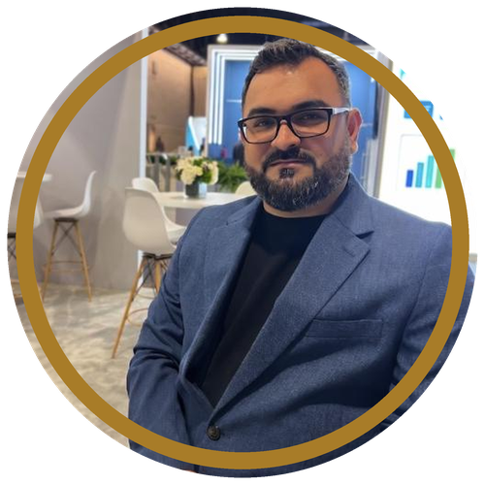

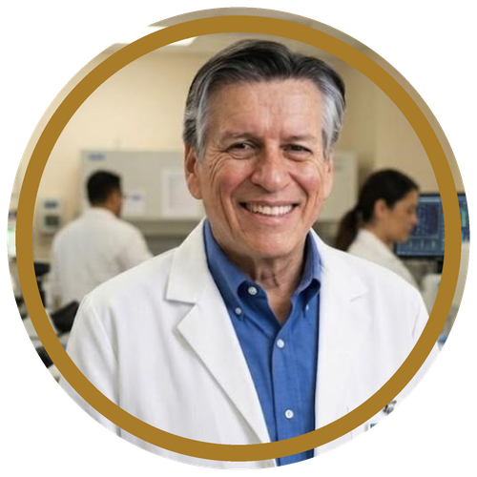
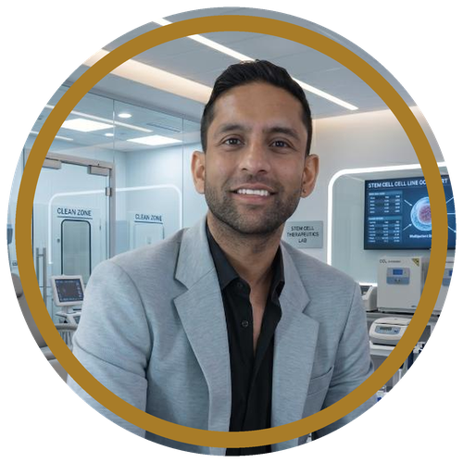

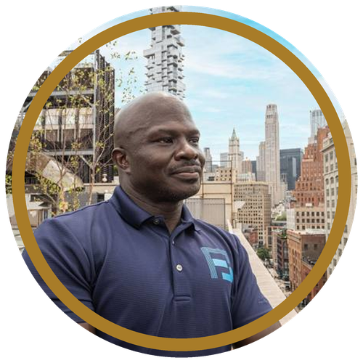
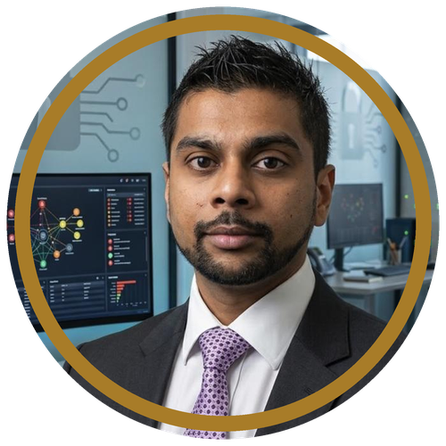


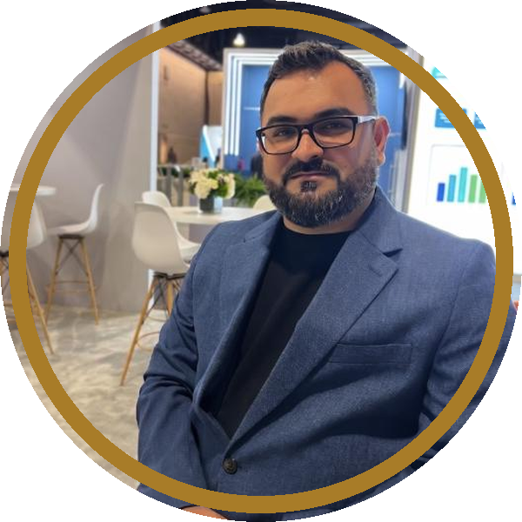

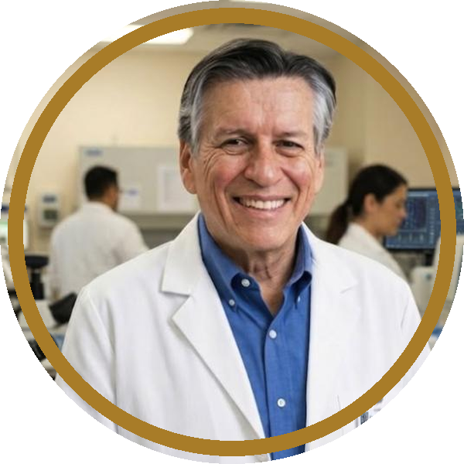
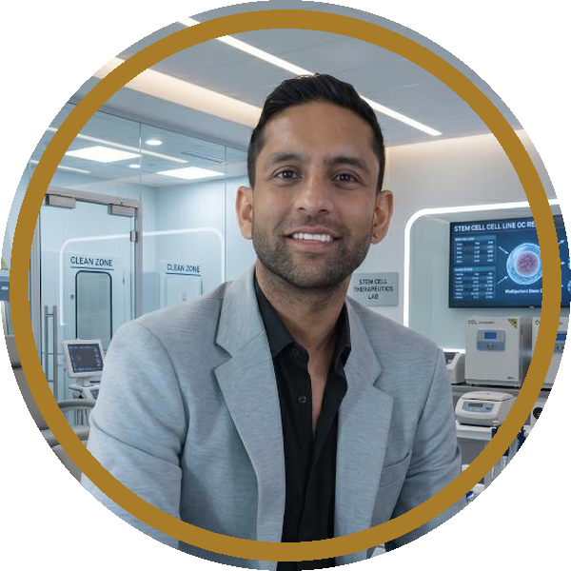

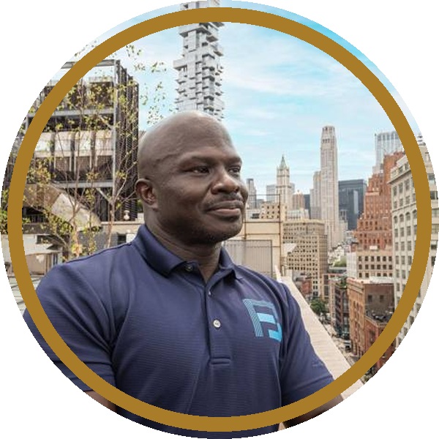
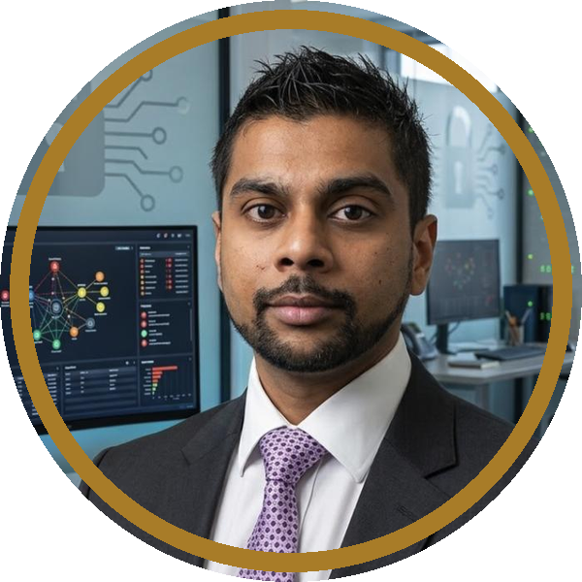


12 LEADERSHIP
Eight leaders. 49 states. Full clinical governance.
Dr. Gaurav Patel, MD
Dr. Asif Kundi, MD
Dr. Richard Miller, DC
Dr. Robert Taylor, MD MPH
CHIEF MEDICAL OFFICER
CLINICAL OPERATIONS
NEURORENEW CLINICS
AUVUM BIO CO-FOUNDER
49 state licenses — immediate national expansion capability.
8+ yrs U.S. Dept. of Veterans Affairs consulting; oversees outcomes & protocols.
Functional neurology post-doc. His TN & N. CA clinics = first satellites.
Harvard MD/MPH · 40+ yrs · Harvard AIDS Institute · LatAm regulatory pathways.
Jaye Patel
Dr. Ali Khan, MD
Dr. Chuck Morris
Mihir Sharma
FOUNDER · BUSINESS DEVELOPMENT
CLINICAL GOVERNANCE · USMLE100
FULCRUM PERFORMANCE LABS
CHIEF TECHNOLOGY OFFICER
Harvard · HMS Stem Cell Medicine ('26). RegenHealth BD; India & Colombia research pathways.
IRB oversight · published research · medical professor at a Miami medical university.
Ex-CEO, NFL Alumni Performance Lab. Inventor, NovaKey™ + SSBreath™. Operating flagship locations in NY, NJ & Dominican Republic.
VaultCyberLab — cybersecurity-first EHR, telehealth & data architecture.
AETHERA MEDICAL GROUP · PRIVATE & CONFIDENTIAL · aetheramedical.com

Slide 15
13 RETURN SCENARIOS
What $5.5M becomes — three exit multiples.
Exit multiple (Year-5 EBITDA of $6.8M) | 8× | 10× | 12×
Implied enterprise value | $54.1M | $67.6M | $81.2M
Investor 20% stake | $10.8M | $13.5M | $16.2M
Capital repaid via profit share | $5.5M | $5.5M | $5.5M
Post-repayment distributions (M42–60) | $2.0M | $2.0M | $2.0M
Total value to investors | $18.3M | $21.1M | $23.8M
MOIC on $5.5M | 3.3× | 3.8× | 4.3×
BASE CASE
3.8×
5-yr MOIC at 10× exit — before satellites, flagship, franchise expansion, tax credits or IP value.
Healthcare platform M&A comparables commonly transact at 8–15× EBITDA. Base-case gross IRR ~38%. MOIC assumes the investor 20% stake is undiluted through exit and includes unrealized equity value. Projections are management estimates; actual results may differ materially.
AETHERA MEDICAL GROUP · PRIVATE & CONFIDENTIAL · aetheramedical.com

Slide 16
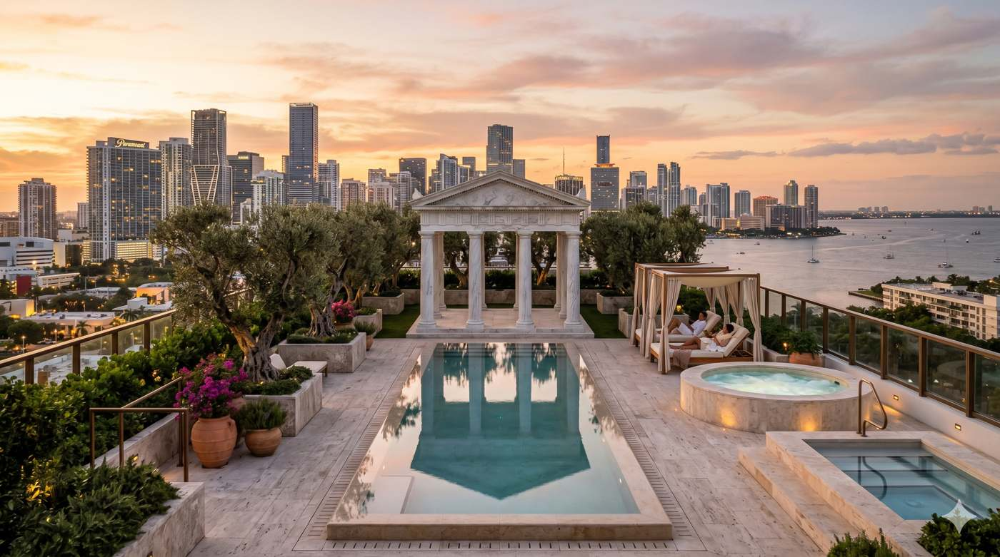

Ten clinics. Four engines. One brand.
Repaid first — owner forever.
$5.5M
Month 41
3.8×
RAISE
BASE-CASE PAYBACK
BASE-CASE MOIC
Jaye Patel · Founder · office@aetheramedical.com · aetheramedical.com
Confidential. Not an offer to sell securities. Any offering made only via definitive documents under Reg D 506(b). Certain regenerative therapies are investigational and not FDA-approved for specific indications; forward-looking projections involve substantial risk including total loss of capital.

